Slide 1

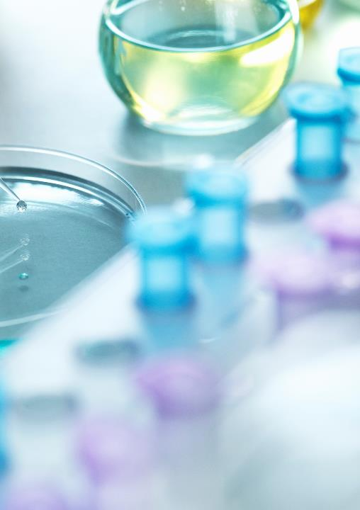
MITOCHONDRIAL GENE STUDY WORKFLOW AND RESULTS
ERIC ZHUANG 2026-07-20

Slide 2

Imported Data
ROSMAP_clinical.csv:
Information on patients (cognitive function, sex, APOE) Atoms
Cell_meta_data.tsv (latest version):
Cell level information; each cell has a barcode, sample/patient information, cell type
Seurat normalization tools
Pathway information
All 13 protein-encoding mtDNA genes
MitoCarta 3.0 (~1,100 nuclear-encoded genes relevant to mitochondria)
Extended set of 1,300 further genes, 80 of which are core genes

Slide 3
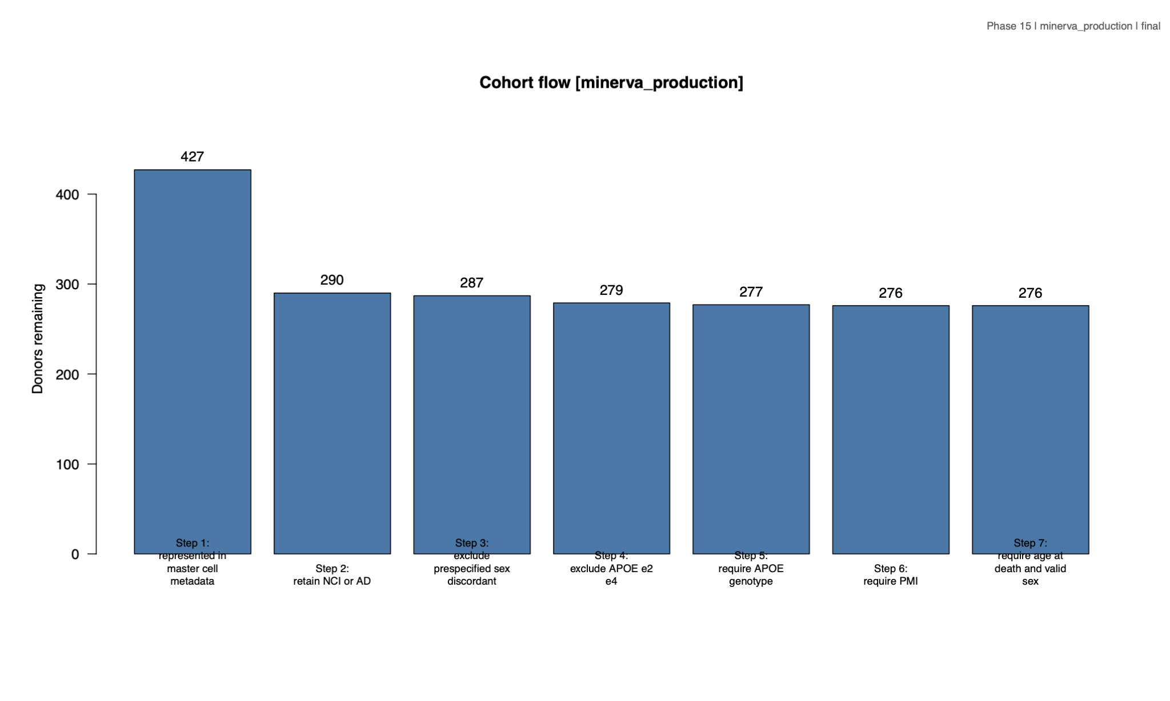
Sample Count and Pre-processing
Remove samples with:
Cogdx besides 1 and 4 (allows division into NCI and AD)
Unclear/discordant sex
APOE genotype ε2/ε4
Missing PMI, age at death, APOE genotype
Create new table of 276 remaining samples
Cap Age at 90

Slide 4
Data Preparation
Audit every seurat object (.rds file), recording dimensions and checking for raw count availability and barcode agreement
Match donor nuclei to metadata
Normalize projids to 8-digit strings
1
2
3
Apply prior mentioned exclusions
Check mitochondrial information:
Validate GENCODE file
Create mapping tables from MitoCarta
Calculate quality control metrics from raw count
Attach donor metadata
4
5

Slide 5
Data preparation (continued)
Normalize raw counts using Seurat(scale factor 10,000). Also validate the prepared data
6
Verifies that each contrast has enough donors on each side (at least 5)
7
Report:
- Donors per sex-APOE group
- Detected genes in each sample
- Nuclei per donor each sex-APOE group
- p-value

Slide 6

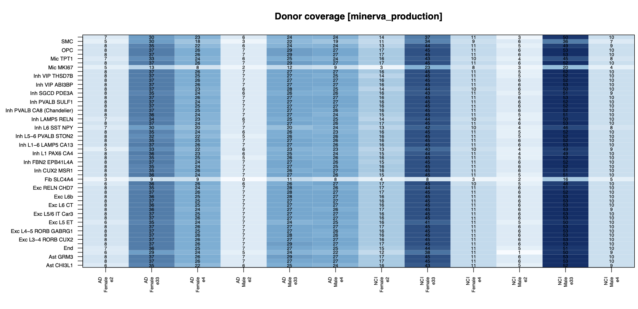
Processed data format
Each processed .rds file consists of two tables(gene expression per gene & cell), first is raw and second is normalized
142 NCI and 134 AD donors

Slide 7
ANALYSIS
MAST analysis, similar to in literature, uses nuclei from each sex-APOE-fine cell type group
Input is normalized RNA data
Program compares AD vs NCI within each sex-APOE group and fine cell type, with min.pct
Variables:
Min.pct = 0.10
No Logfc threshold (only p/q-value affect classification of the gene)
Age, PMI and other variables are recorded but not used (for now)

Slide 8
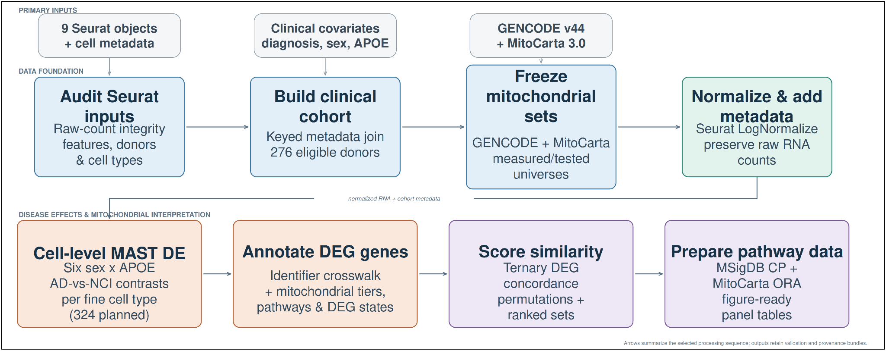
ANALYSIS (CONTINUED)
Score similarity:
Ternary values for DEGs (0, ±1); very similar to Zhang-Yu similarity analysis
Pathway analysis using imported pathways

Slide 9

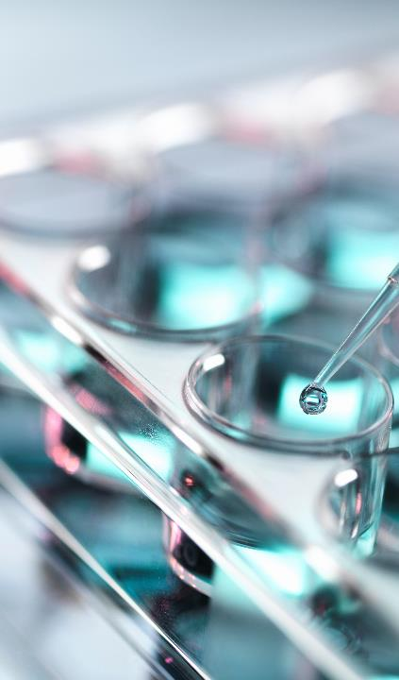
Current Results

Slide 10
MAST ANALYSIS RESULTS:
Acquired Log2FC and p-values for each gene across each comparable contrast, among other information.
Variation in number of upregulated genes by cell type
Upregulated and downregulated genes identified for each contrast
Detailed data chart is in the PDF:
https://drive.google.com/file/d/14K6yCfam_YlAVahgRYXq79aZ5dxnhDEE/view?usp=drive_link

Slide 11
Data/Figures

Slide 17
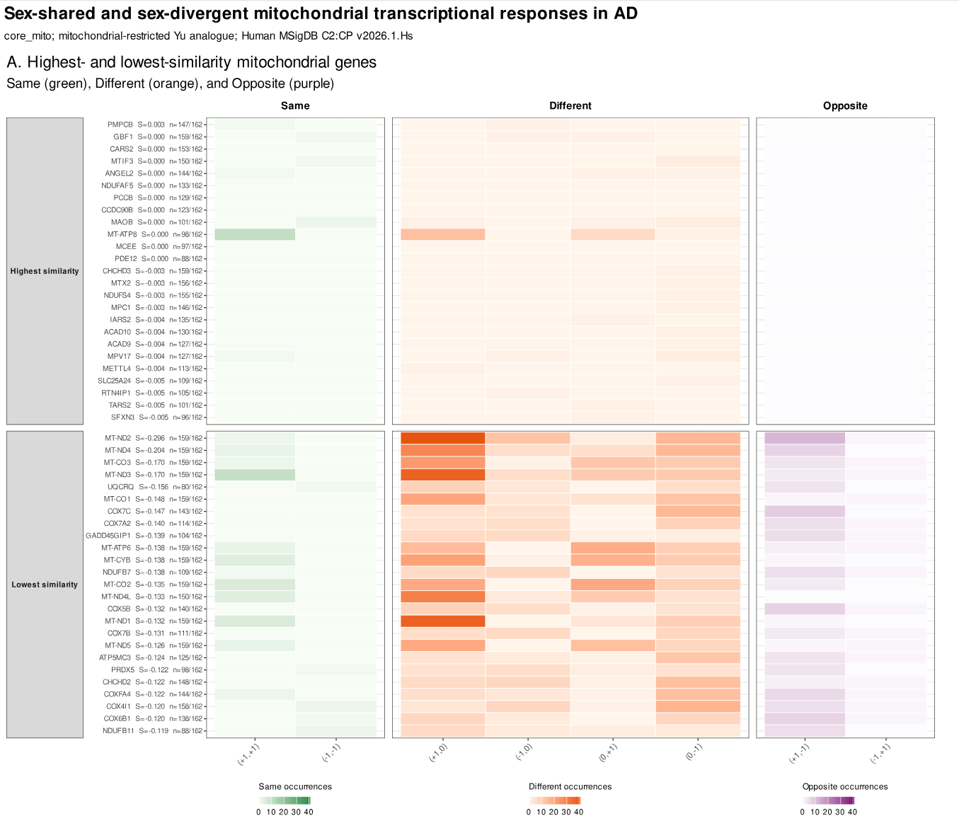

Slide 18
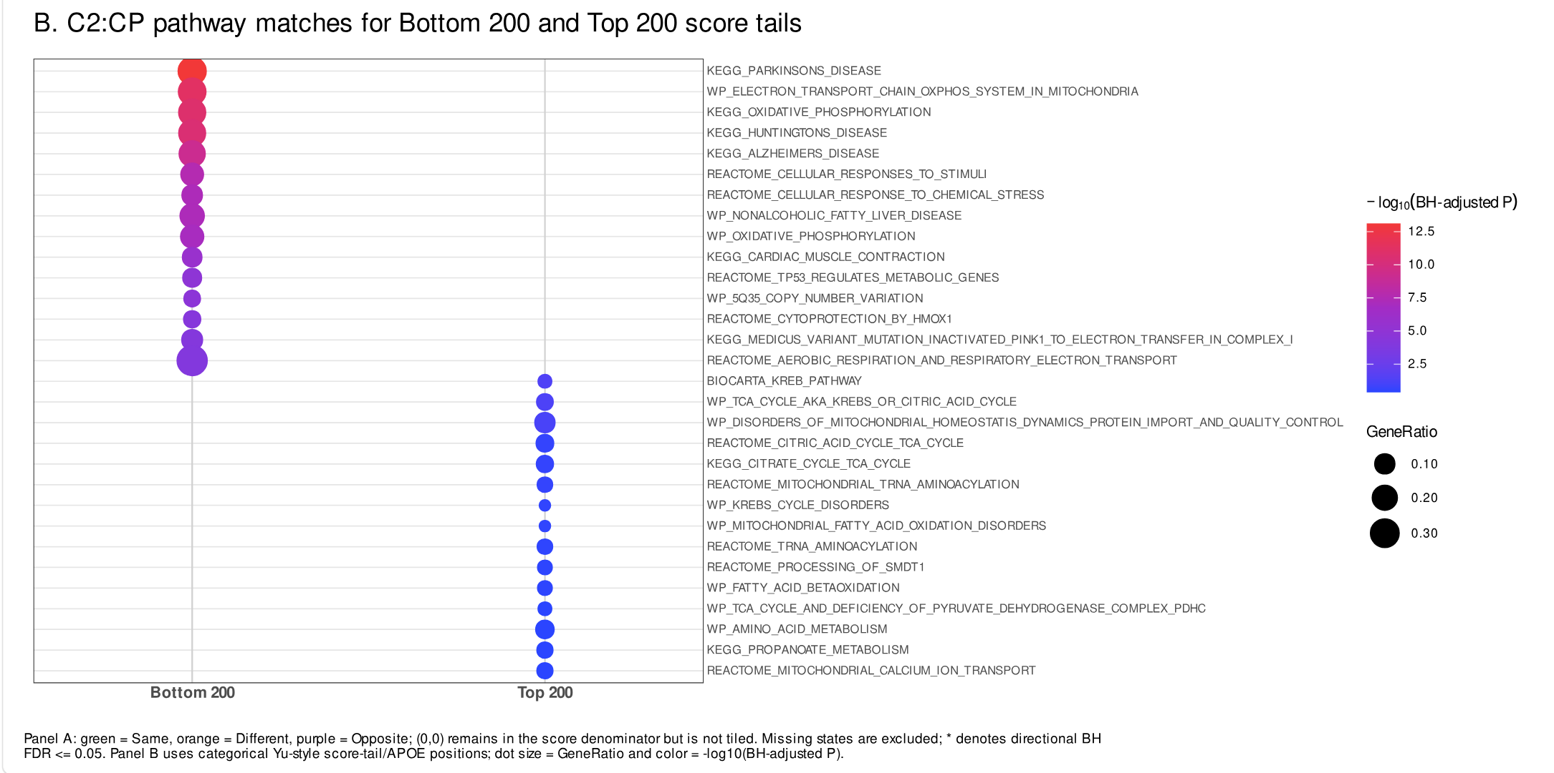

Slide 19
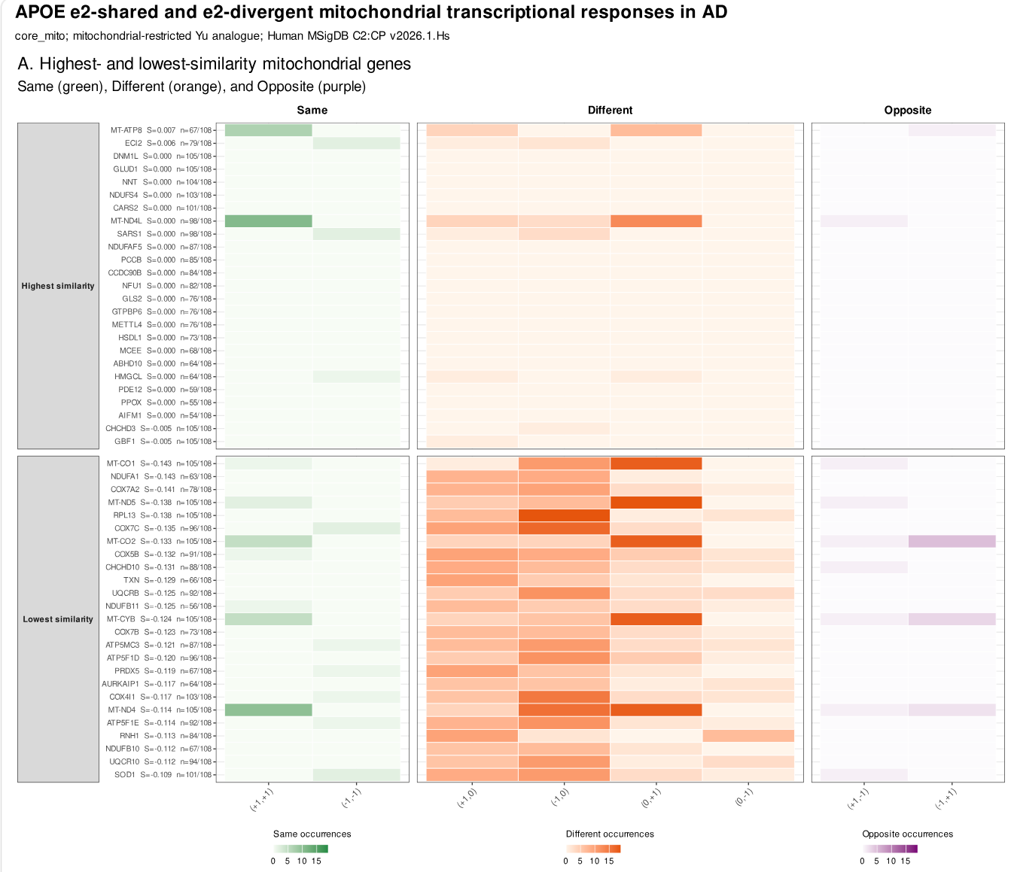

Slide 20
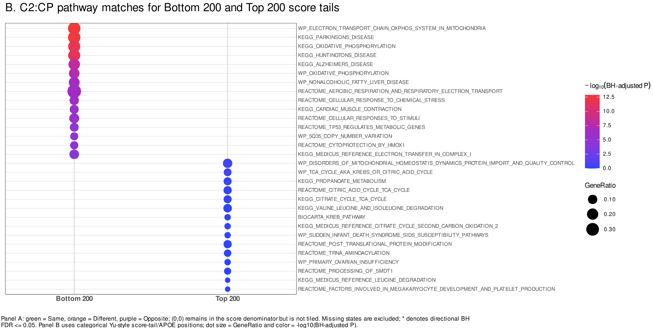

Slide 21
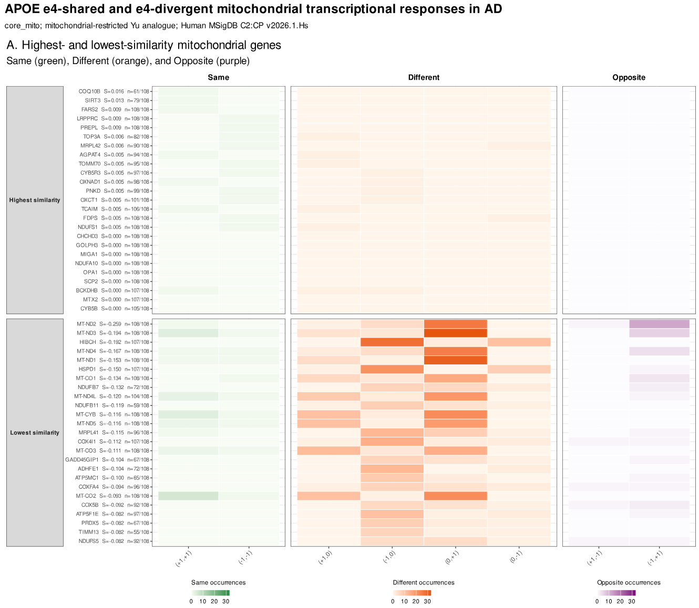

Slide 22
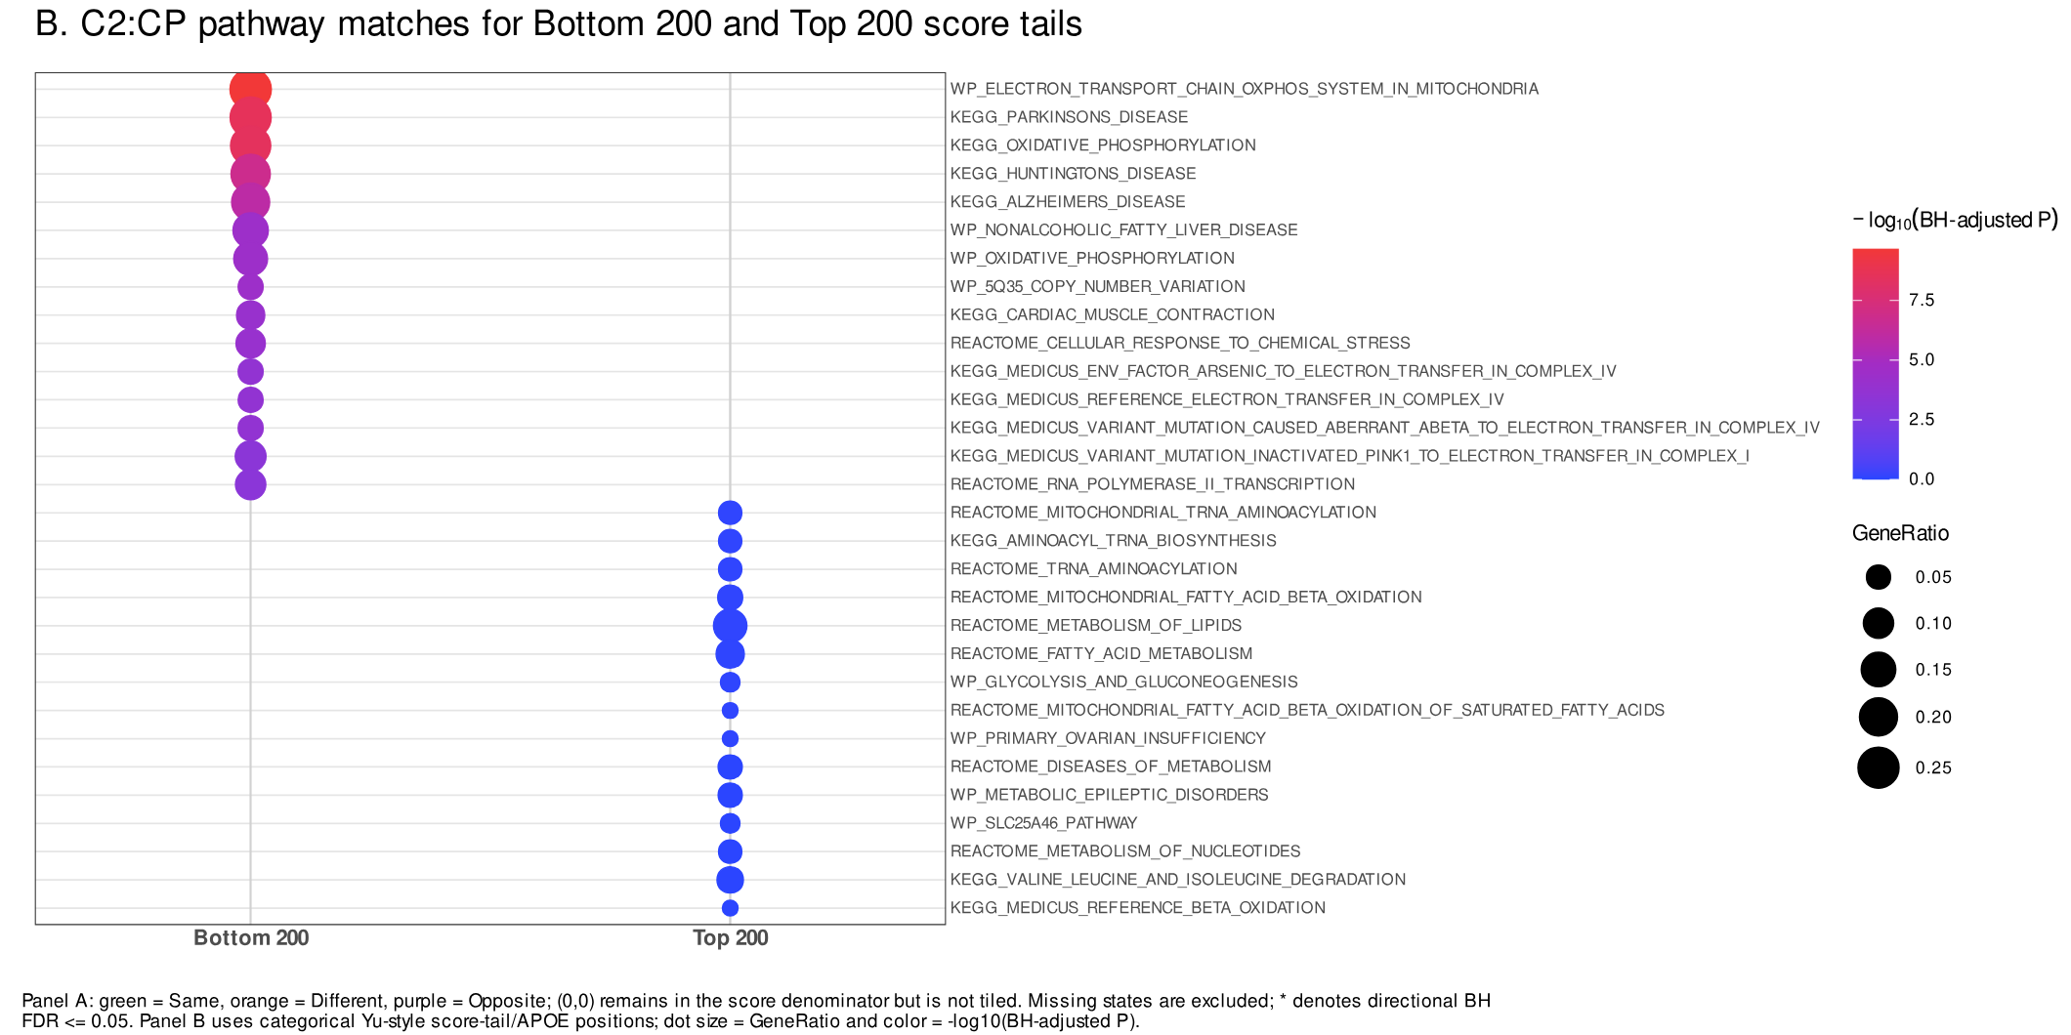

Slide 23
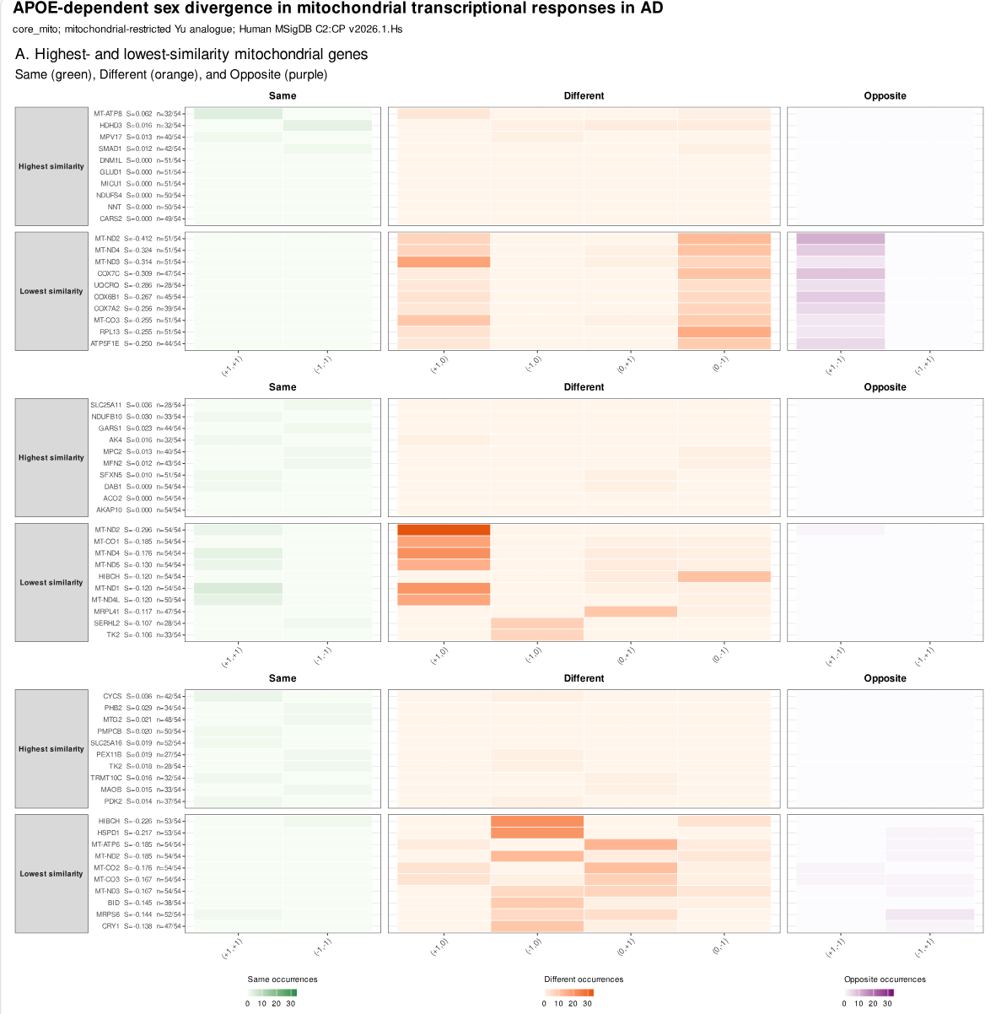

Slide 24
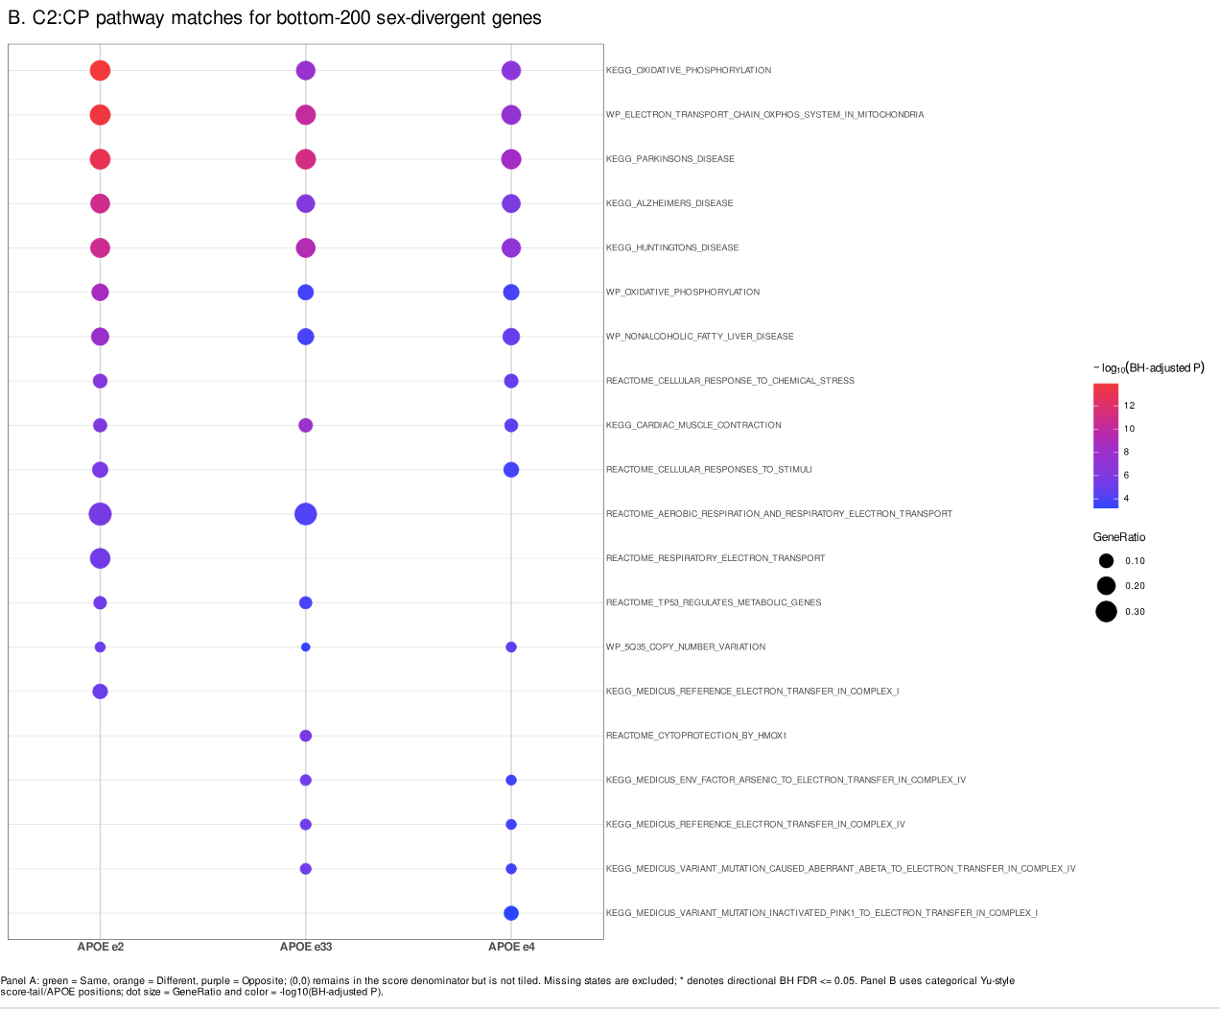

Slide 25
GENES STUDIED
Roughly 10% of genes were removed from analysis by q-value
This included 1 mtDNA gene
This amount is distinct from in the original analysis; the issue could be in how q-value is calculated; there are different algorithms/scripts available.

